Slide 1


Exploring the Synergies Between Biodiversity and Human Use of Urban Greenspaces
Department of Wildlife Ecology and Conservation, Fort Lauderdale Research and Education Center, Davie, Florida
Nataly G. Miguez, Brittany M. Mason, Jiangxiao Qiu, Haojie Cao, Corey T. Callaghan

Slide 2
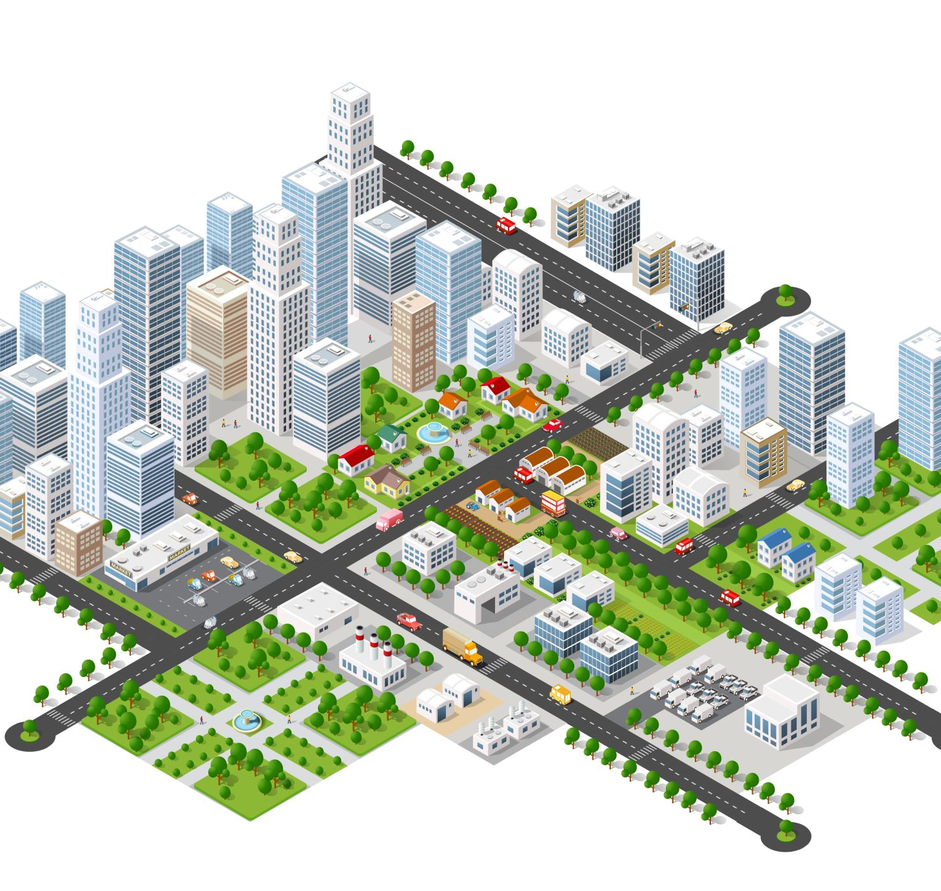
Ecosystem Services of Urban Greenspaces
Urban population is projected to increase from 55% to 68% by 2050
Provide essential habitats and vital ecosystem services
Greenspace: Accessible to the community and designated/managed as parks or recreational space

Slide 3
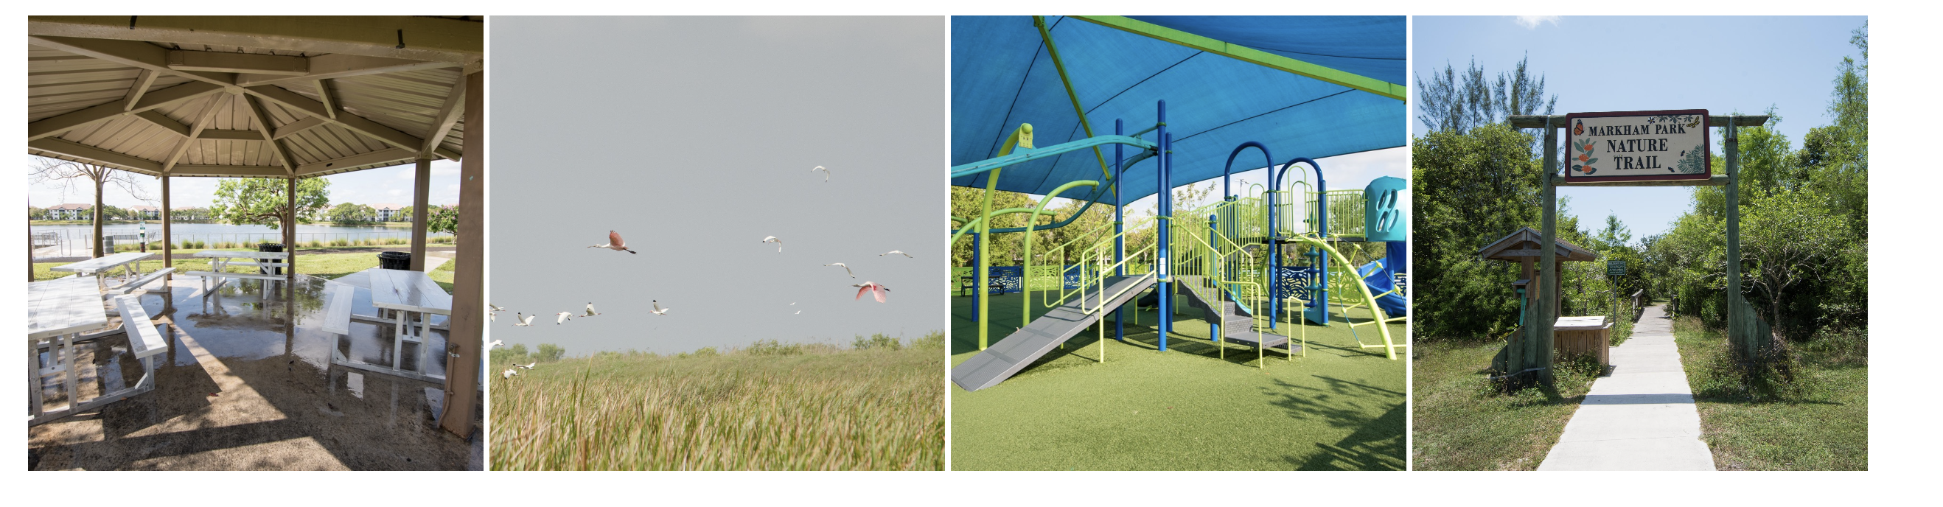
Greenspaces for People
Greenspace planning strategies tend to focus on maximizing the human experience

Slide 4
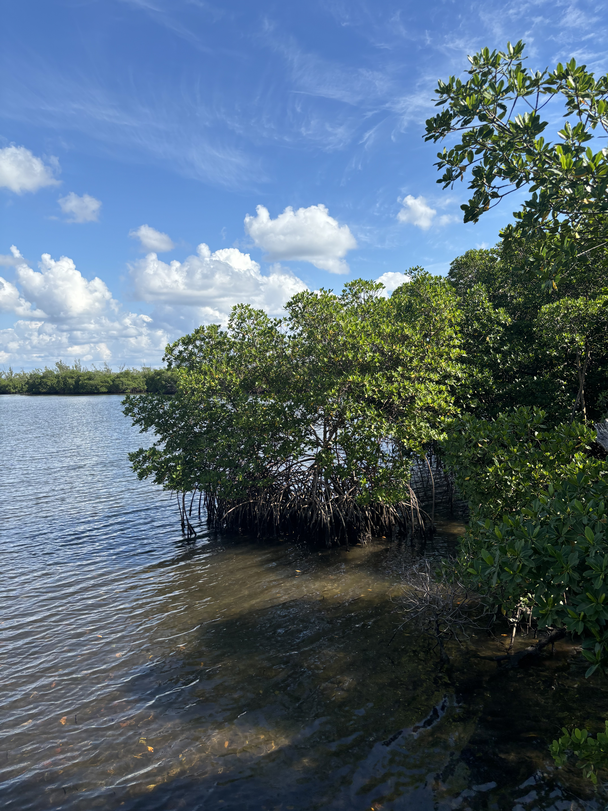
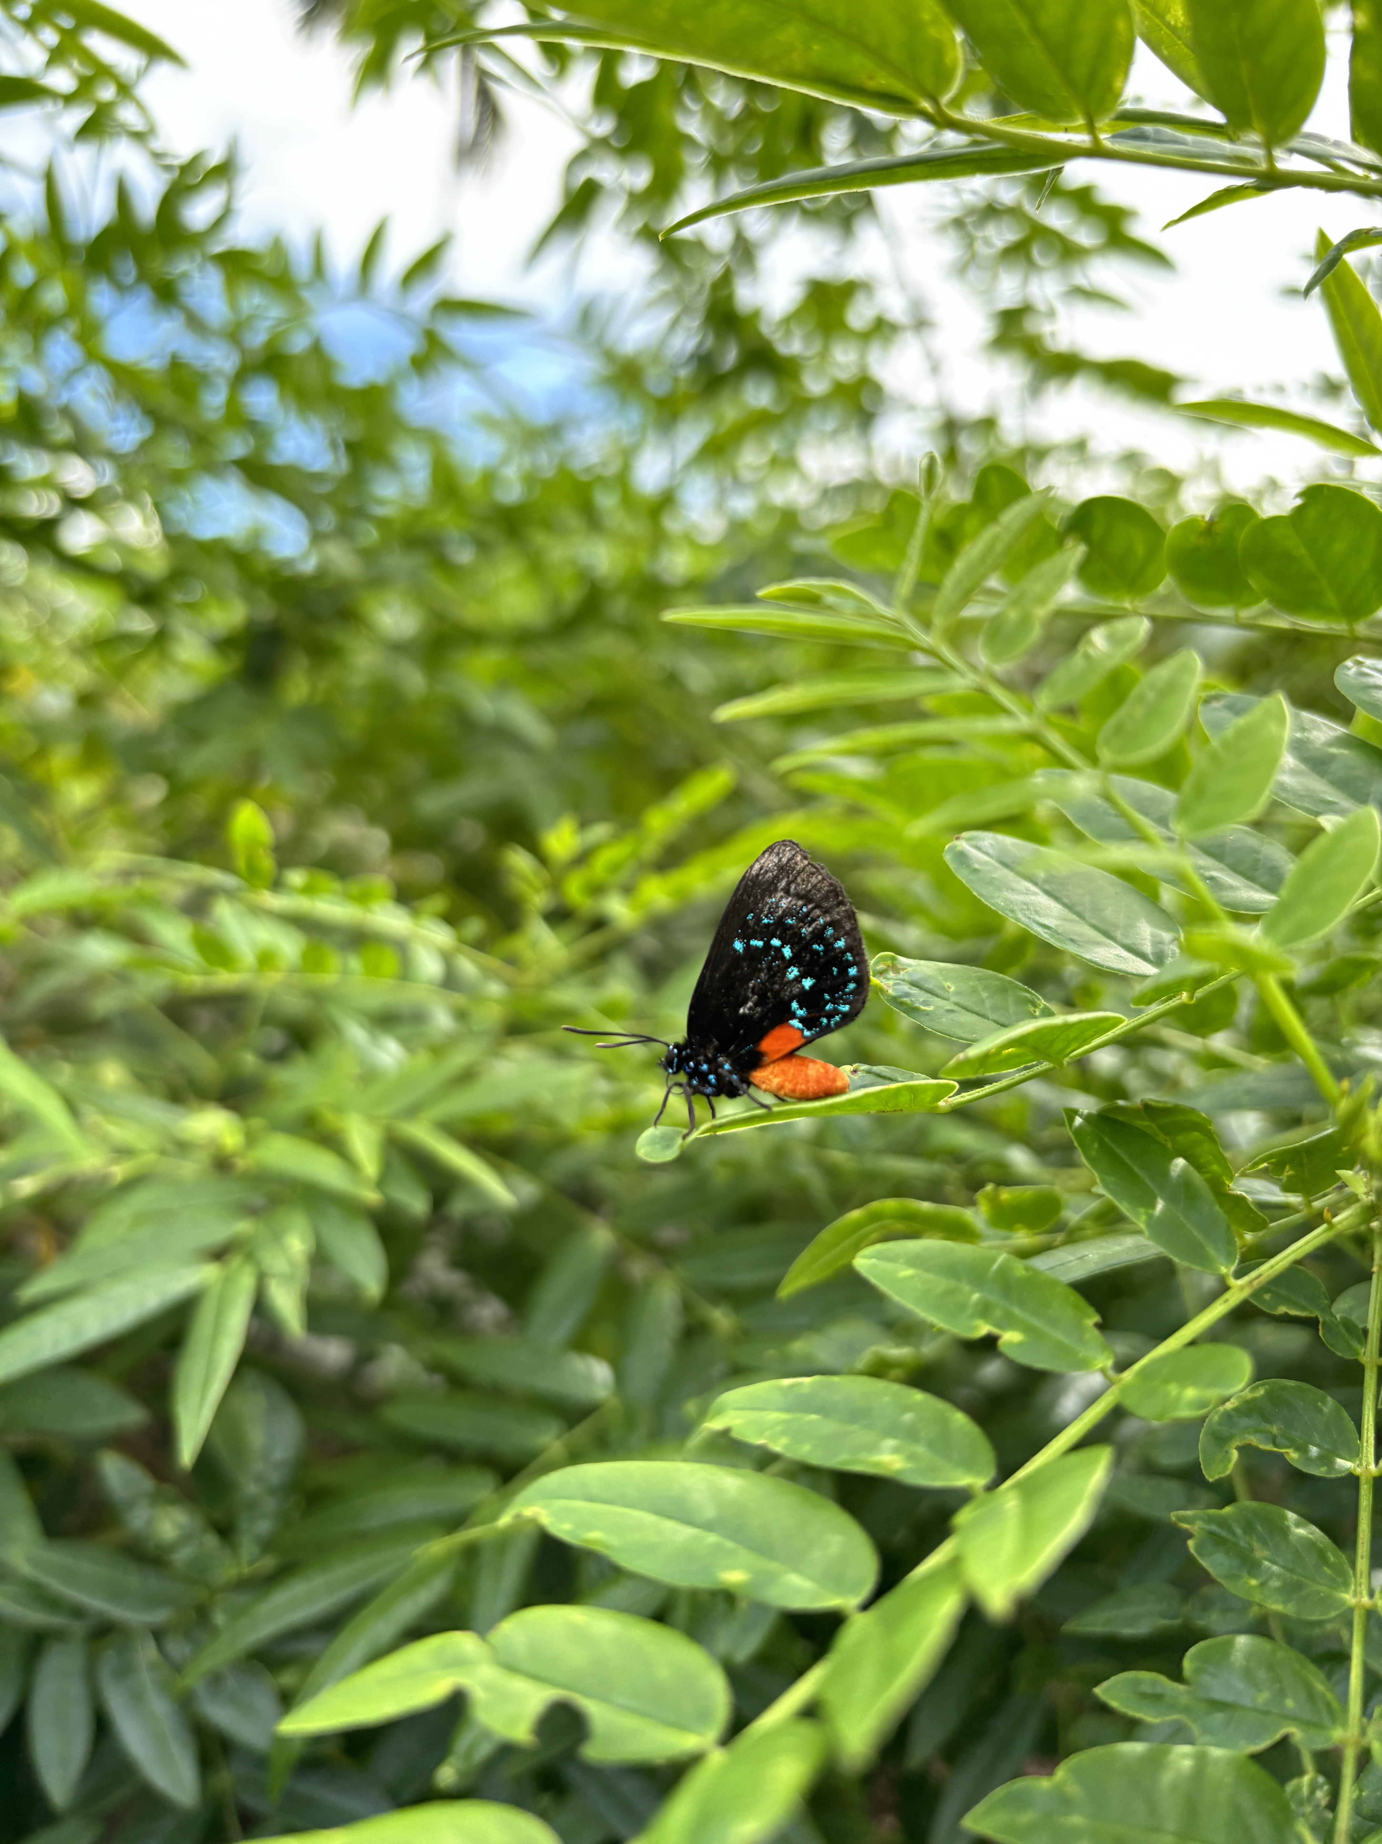
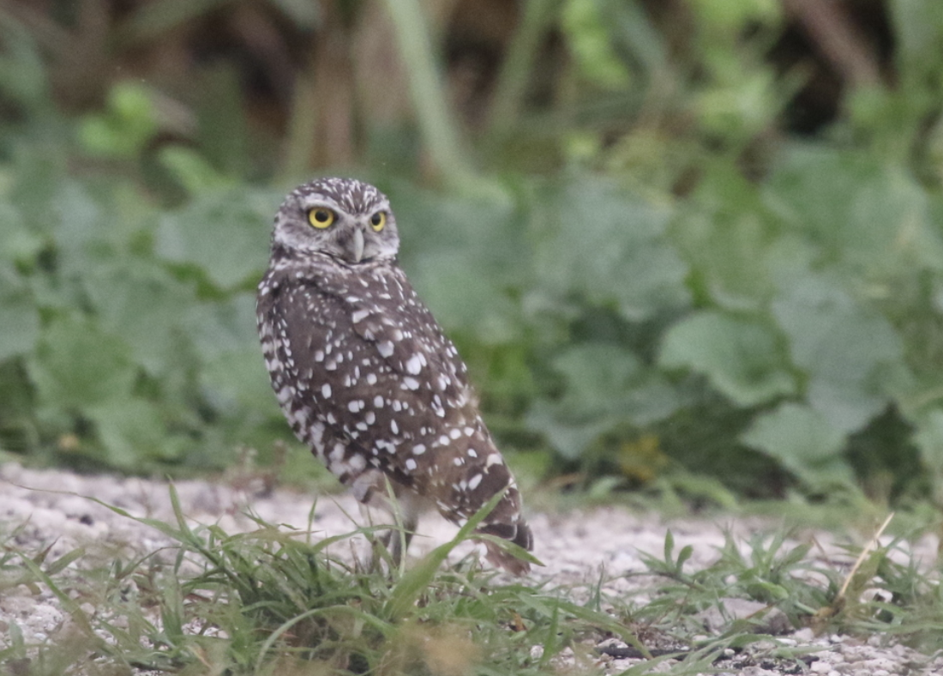
Greenspaces for Biodiversity
Habitats for wildlife
Provide a wildlife corridor

Slide 5
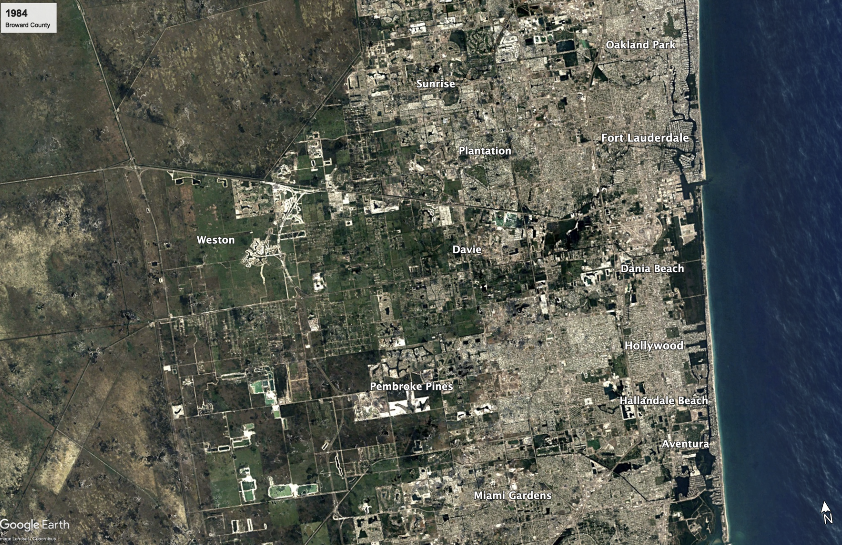
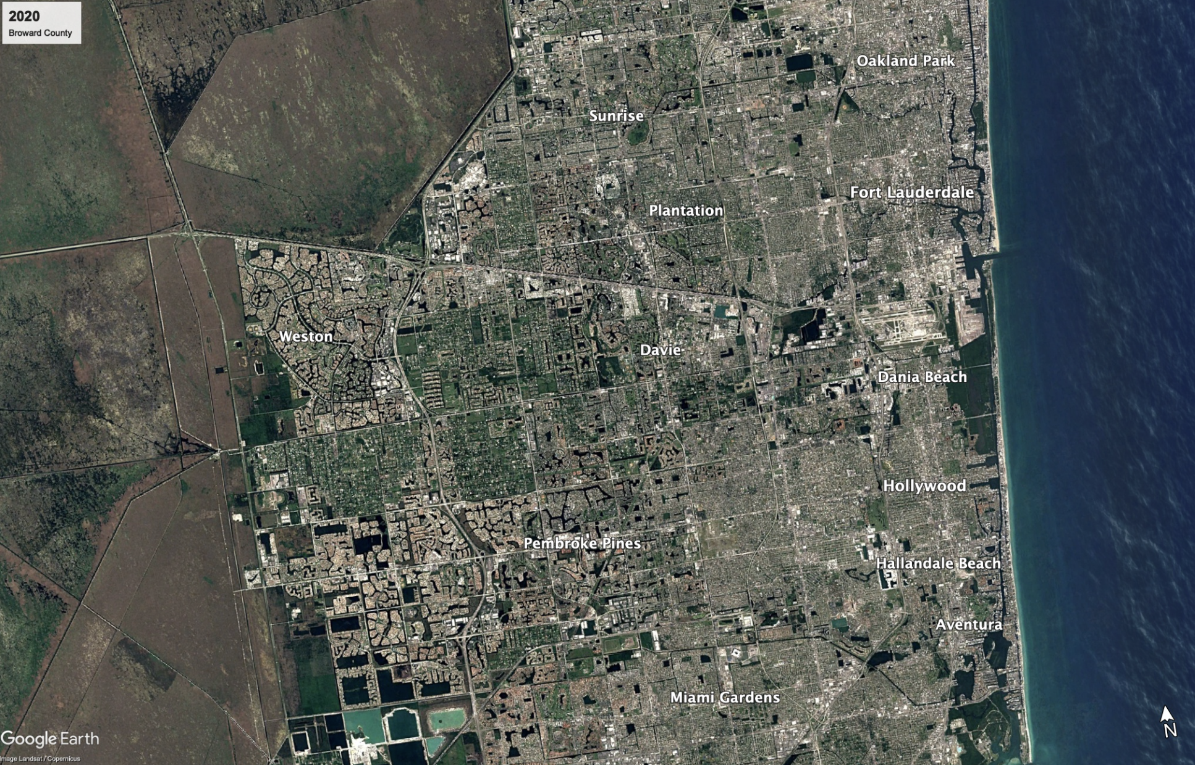
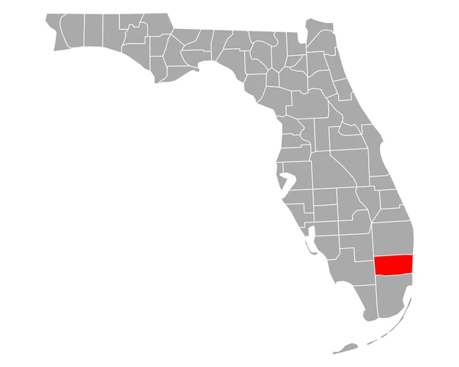
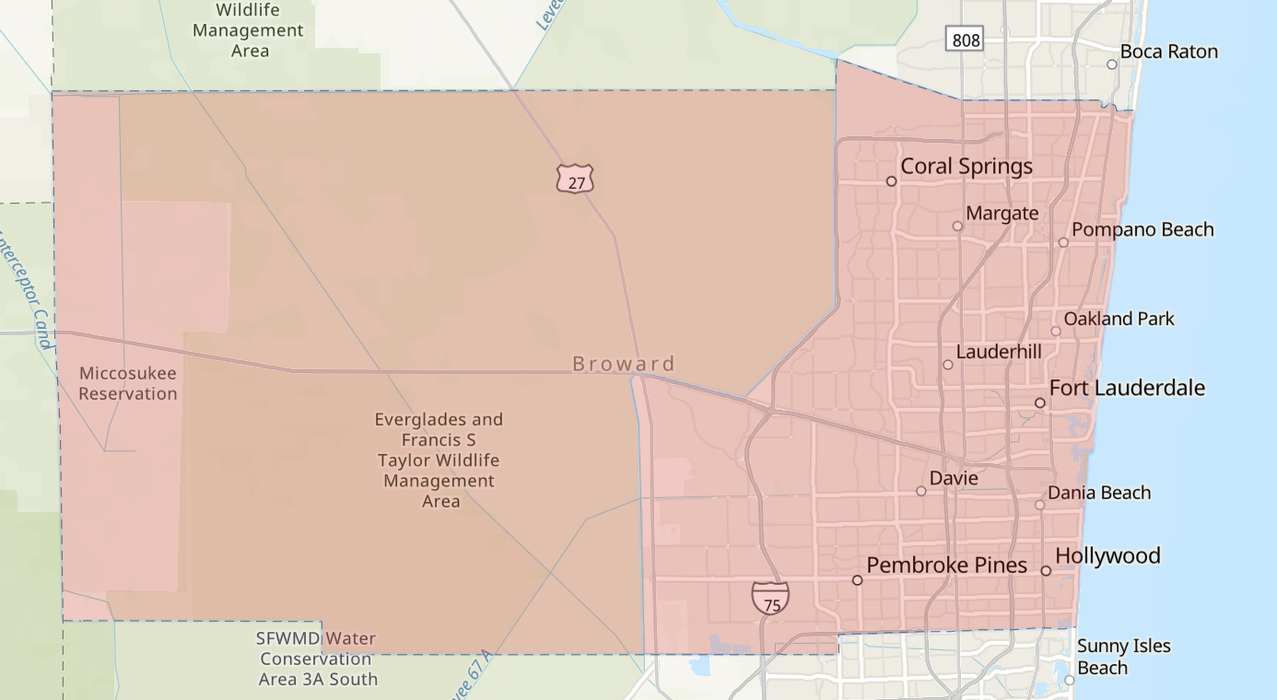
Broward County, Florida
2/3 of the county is Everglades
Unique sub-tropical climate
Second most populous county in Florida

Slide 6
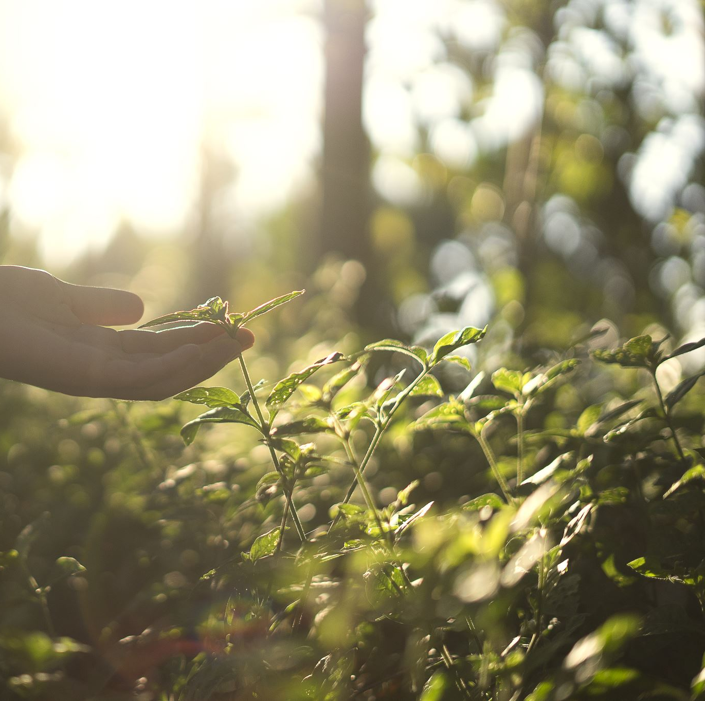
Research Objective
To quantify the synergies and tradeoffs between human utility and biodiversity benefits in urban greenspaces.

Slide 7
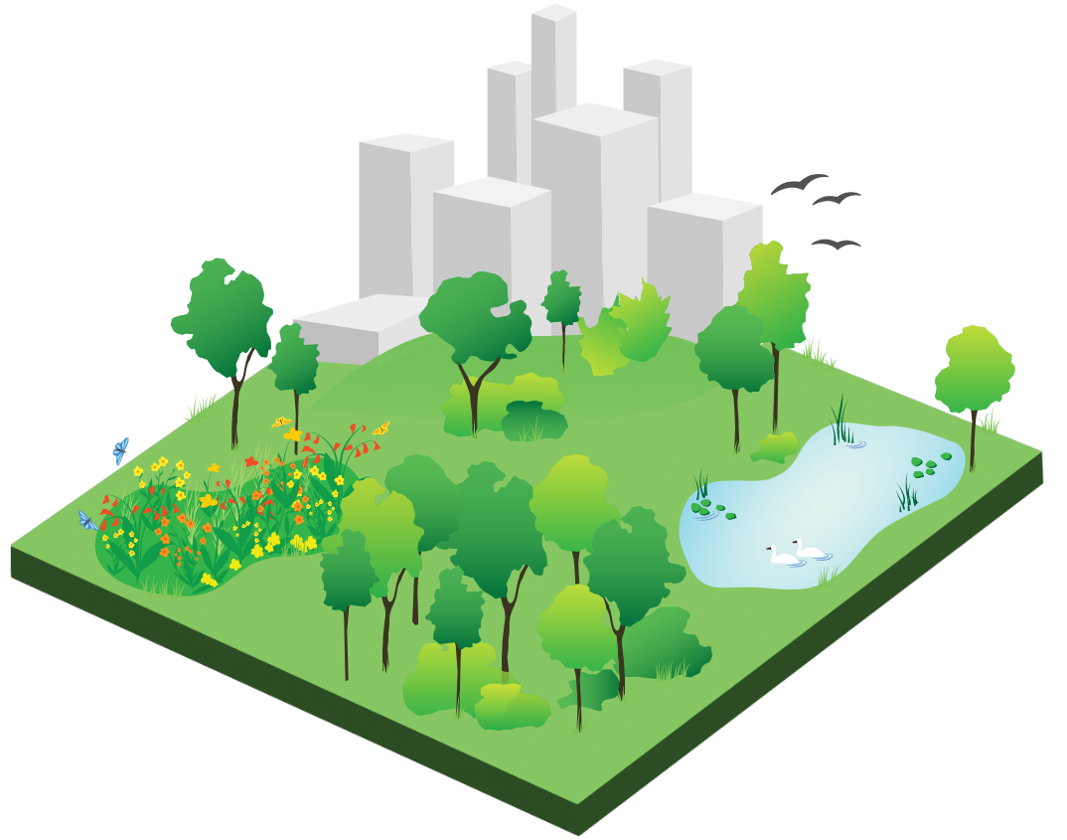
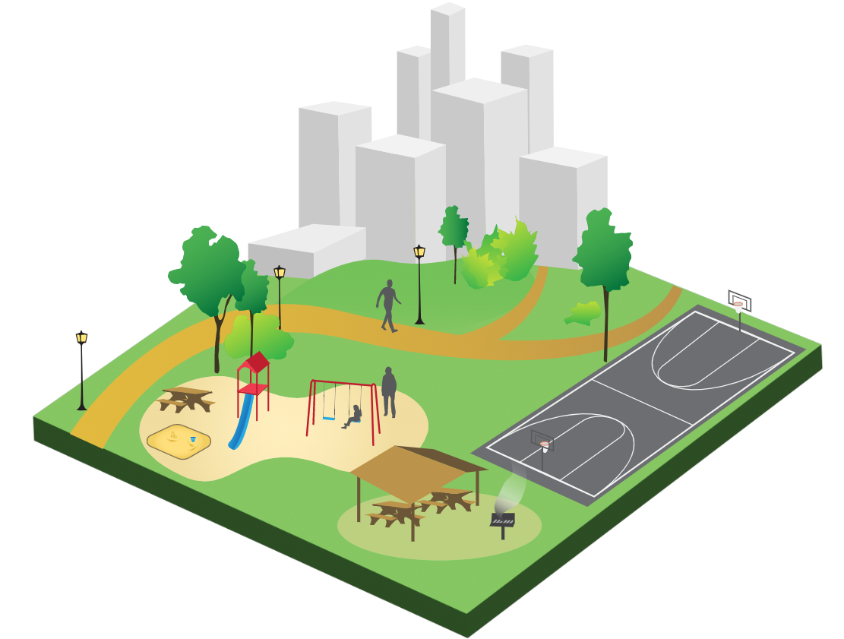
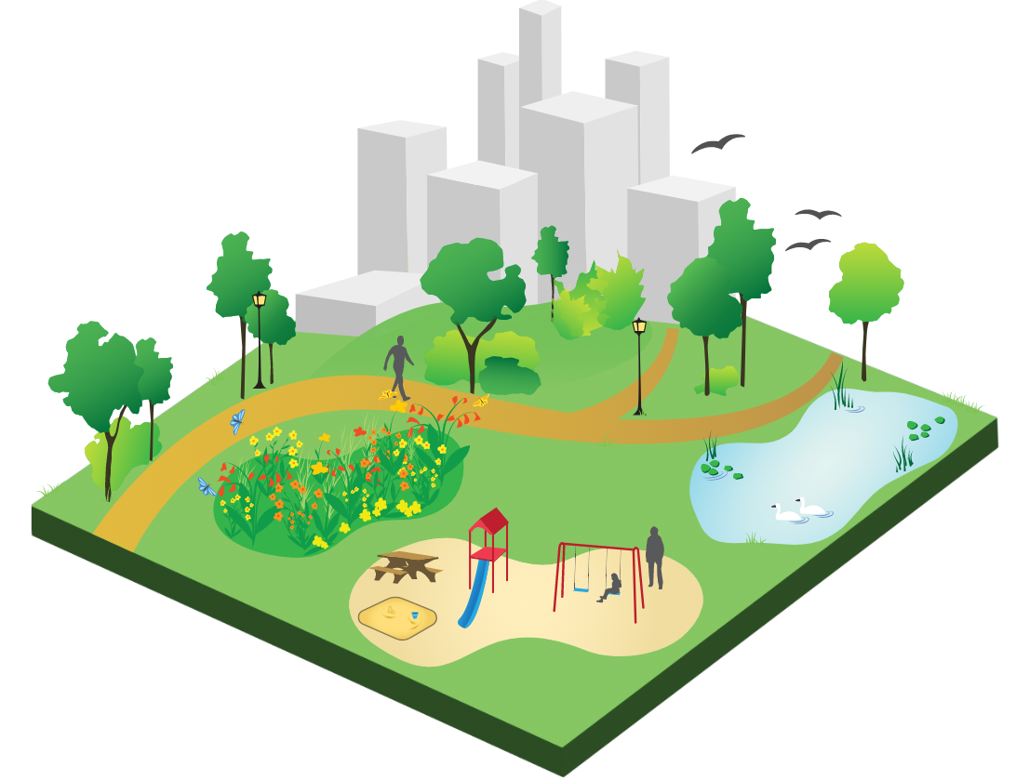








Utility on a sliding scale
High biodiversity utility
High human utility
Nature Preserve
Fitness Center
Body of Water
Athletic Field
Walk Path
Playground
Dog Park
Picnic Area

Slide 8
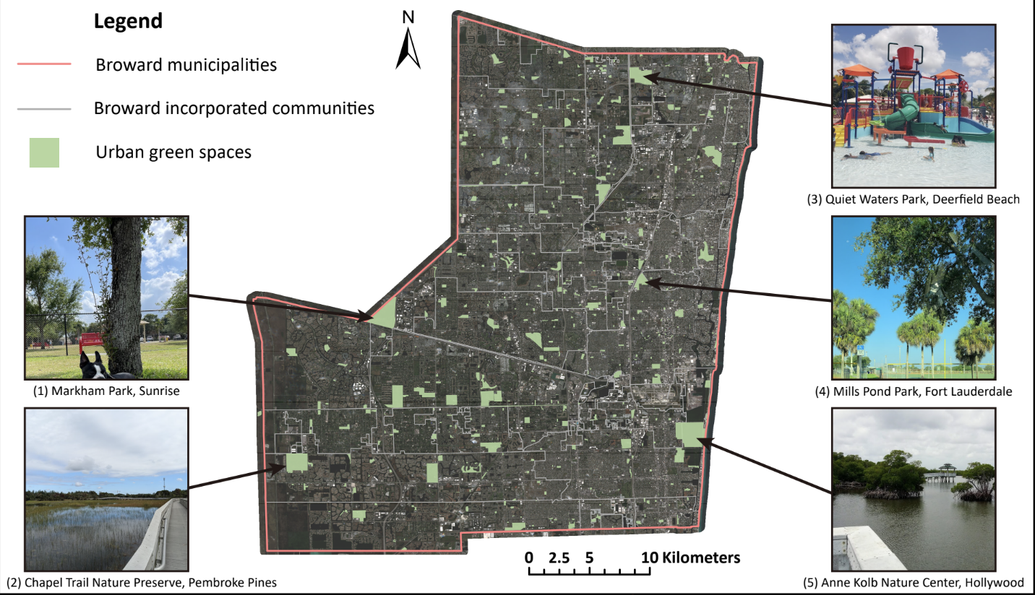
Defining Human Utility
Assessed 639 parks across Broward County
Human utility index – sum of physical attributes
Athletic facilities | Bodies of water
Walking path | Playgrounds
Athletic field | Picnic Area
Nature Preserve | Dog Park

Slide 9
Quantifying biodiversity
Measured biodiversity by looking at species richness
iNaturalist – a citizen science platform
Devised random forest model to predict species richness

Slide 10
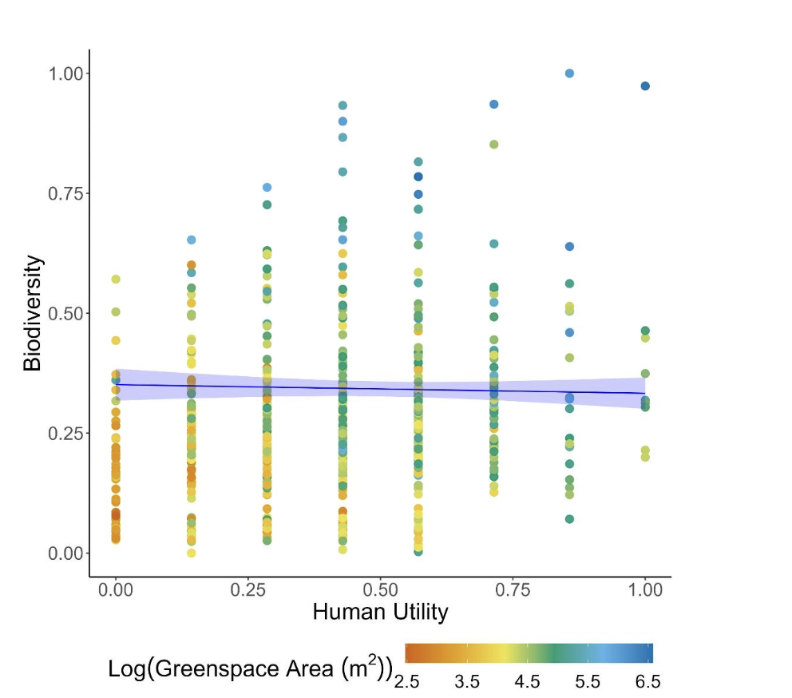
Findings
No significant correlation between biodiversity and human utility
Challenges the division between prioritizing one over the other

Slide 11
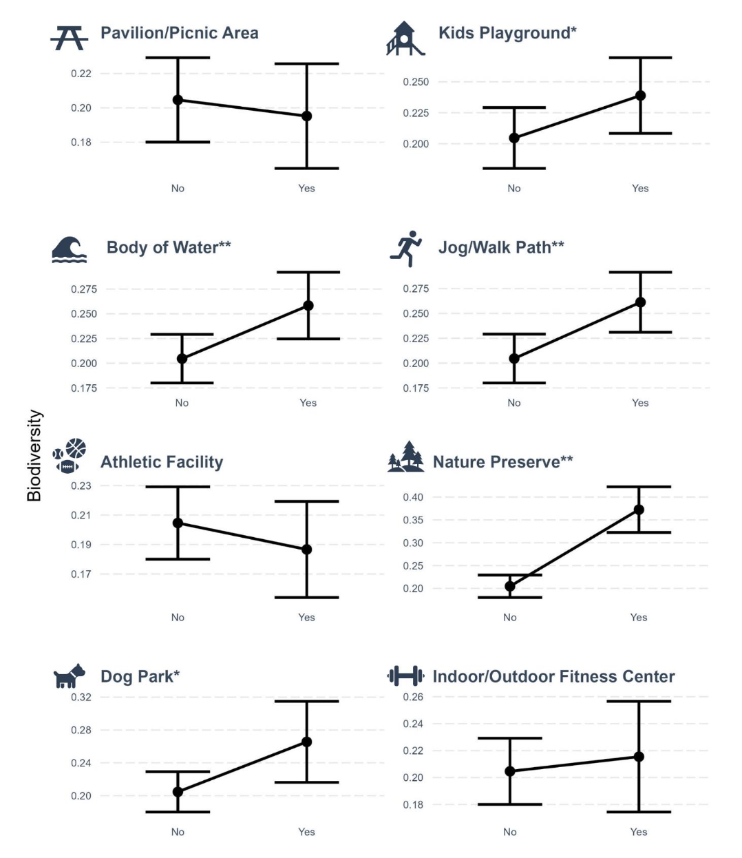
Human Utility and Biodiversity
Bodies of water, kid’s playground, nature preserves showed evidence of a positive relationship
Picnic areas, athletic facilities showed evidence of a negative relationship

Slide 12
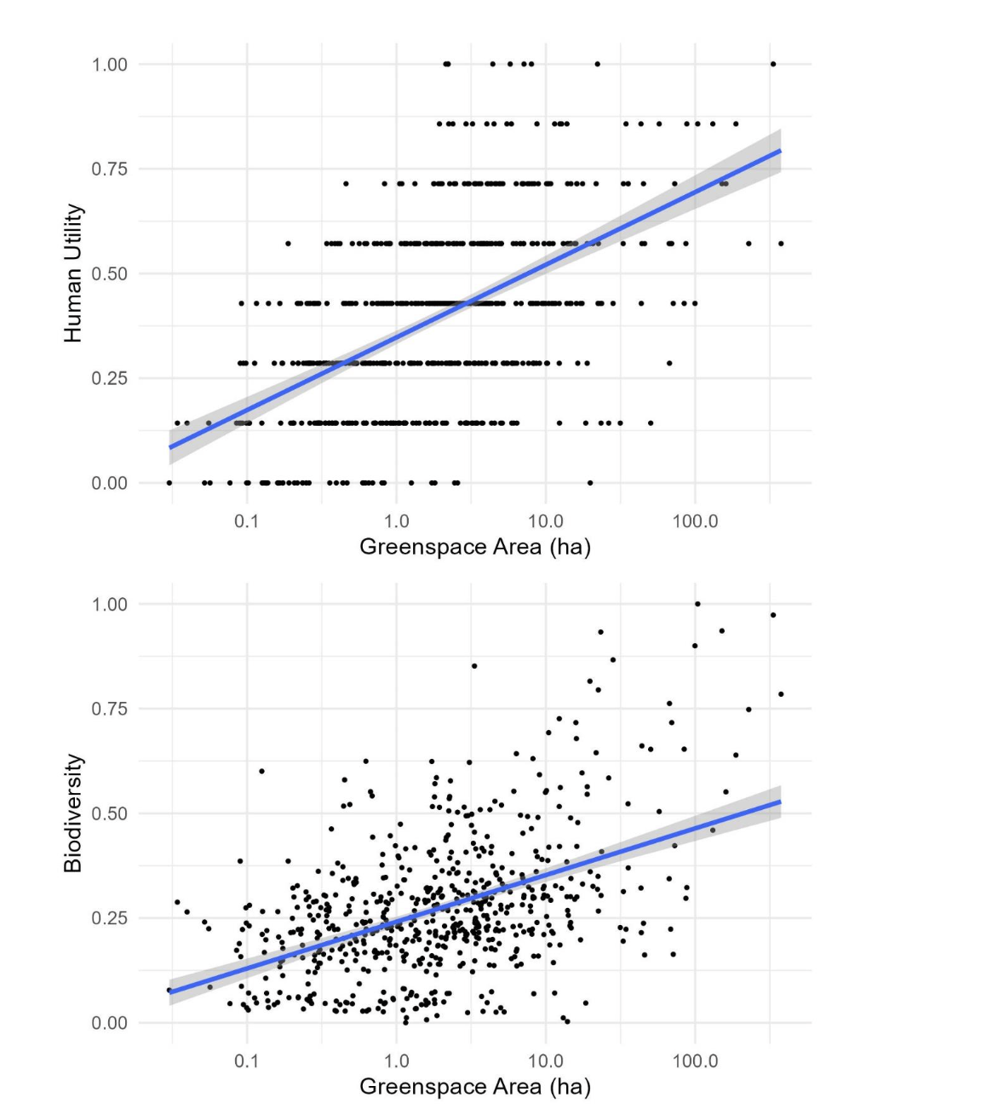
Larger greenspaces can accommodate diverse values
Human utility
Greenspace Area (ha)
Biodiversity
Greenspace Area (ha)

Slide 13
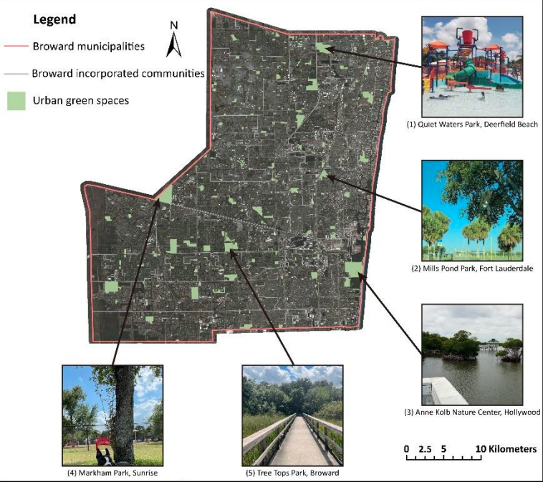
Case Studies

Slide 14
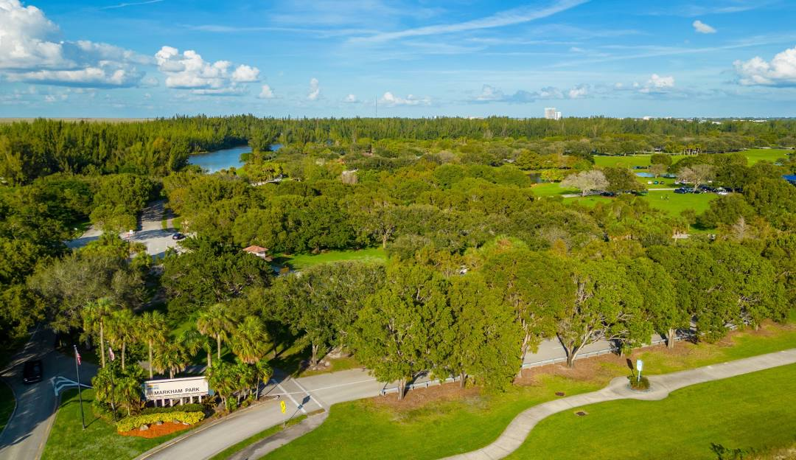
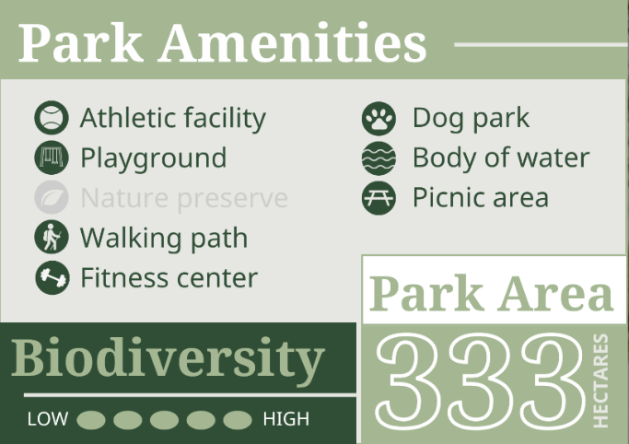
Markham Park: Sunrise, FL
Over 333 hectares
Contains wooded trails, butterfly gardens, lakes
Nearly all human utility variables, and high biodiversity

Slide 15
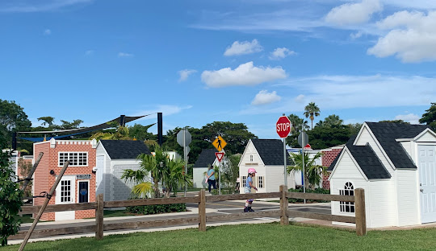
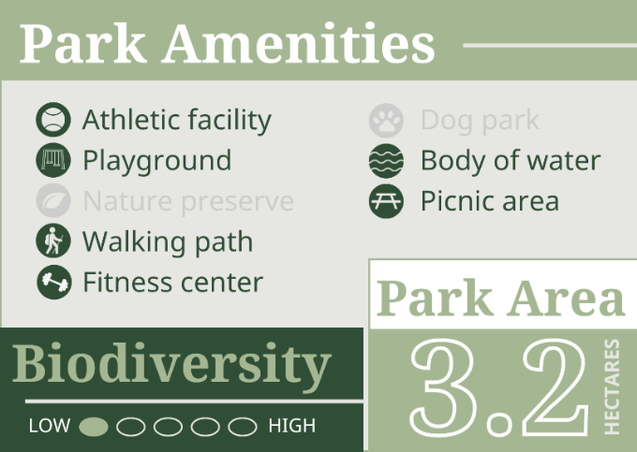
Welleby Park: Sunrise, FL
Nearly 3.2 hectares
Busy community park
Contains paved walking trails, kid sized town, splash pad
Large fields of grass with few trees

Slide 16
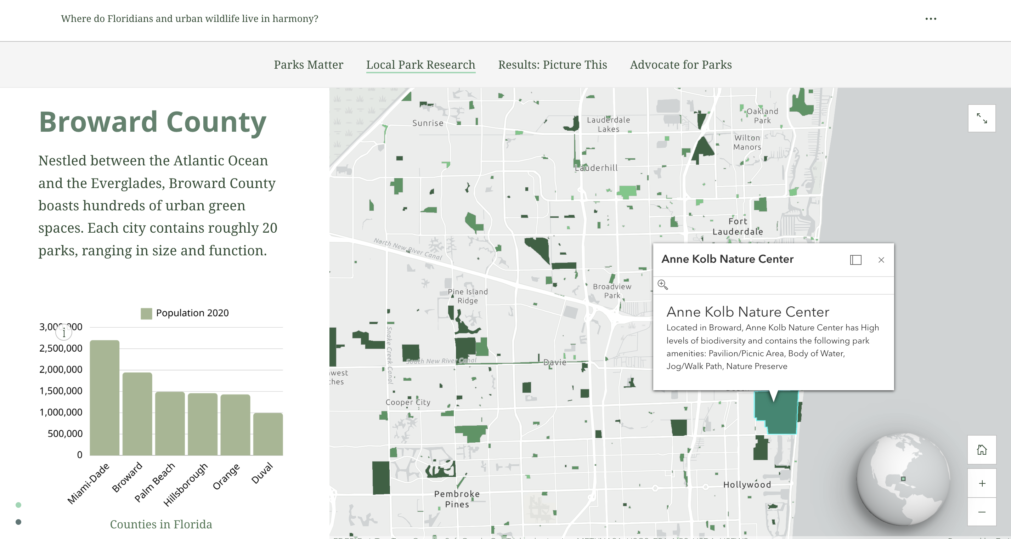

Slide 17
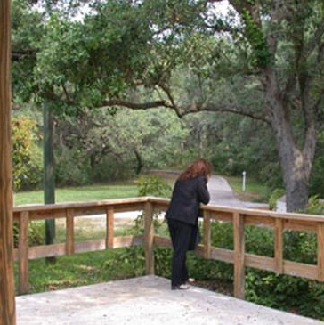
When Park Design Aligns
Greenspaces can support both biodiversity and human amenities without clear trade-offs
Urban greenspaces can be optimized to serve dual purposes effectively

Slide 18

Balancing Social and Ecological Wellbeing
Thoughtful management and design of greenspaces
Signage and educational programs
Become stewards of your environment – use iNaturalist!

Slide 19
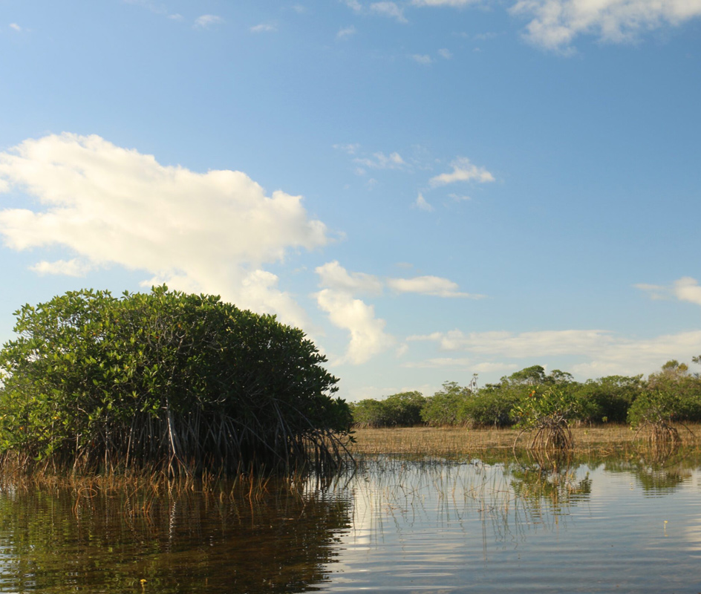
Thank You!
Nataly Miguez
natalymiguez1@gmail.com

